Slide 1
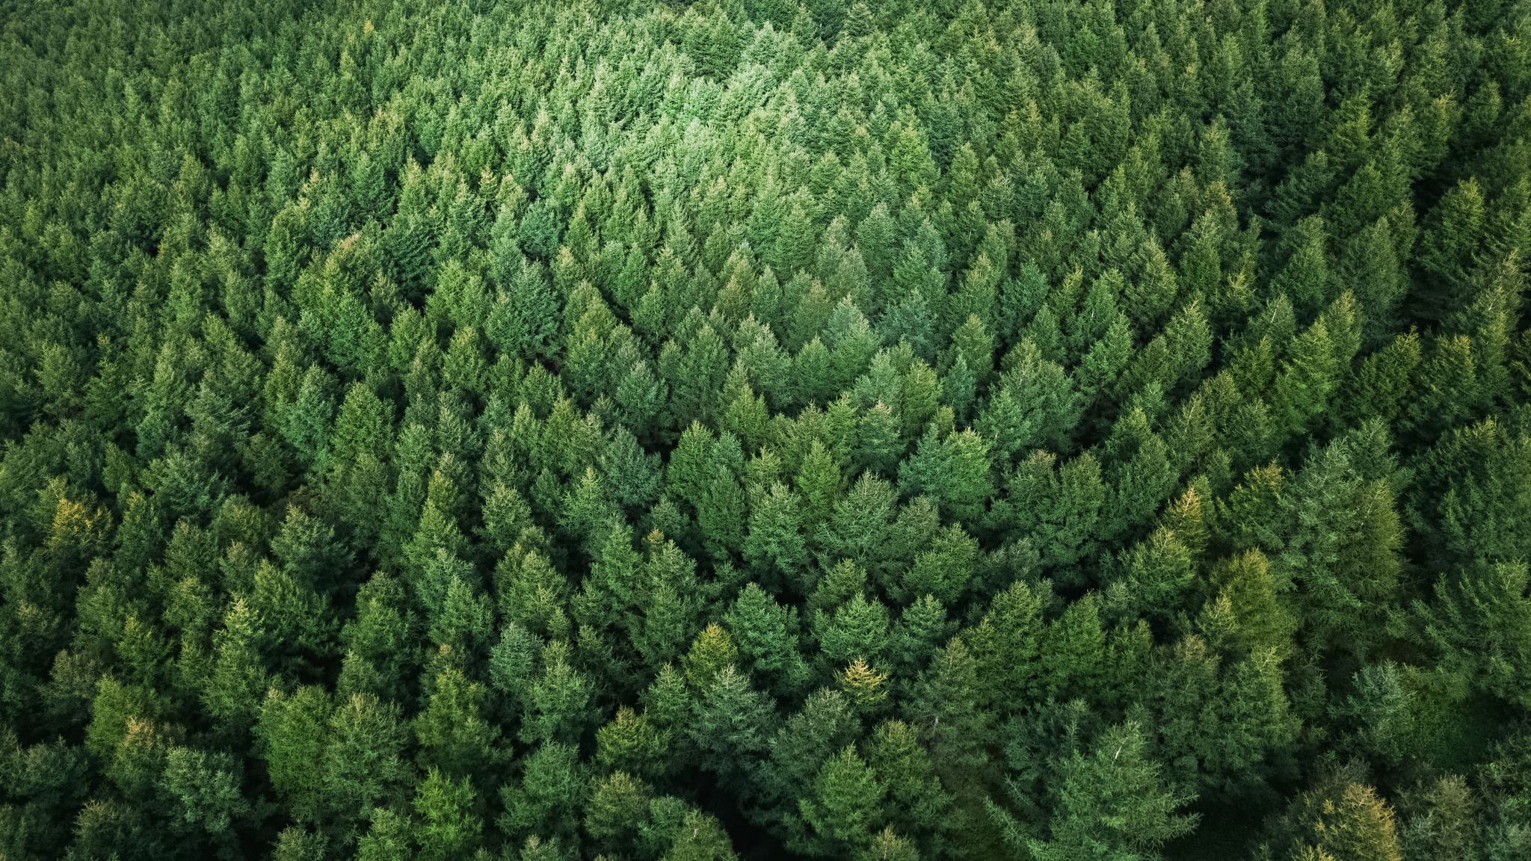
Forest Cover Type Prediction
By Isaac Aguilar

Slide 2
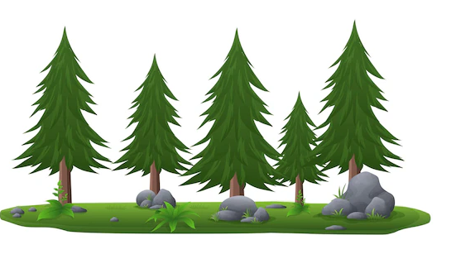
Problem Background
Host: Kaggle - For fun and Practice!
Objective: Predict the predominant kind of tree cover (portion of the land that is covered by the crowns of trees when viewed from above)
Multivariable Problem: 7 categories (They all have 2160 observations)
Data Source: Areas from Roosevelt National Forest (Northern Colorado)
Predictive Variables: 54 (44 are dummy variables) – Elevation, Soil Type, Slope, Wilderness Area, Hill shade, etc.

Slide 3
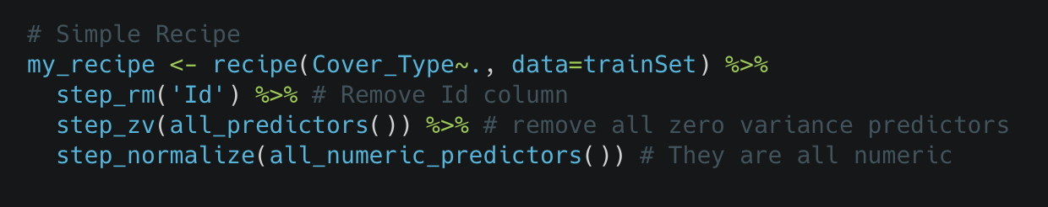
Feature Engineering

Slide 4
Model Comparison
Random Forest | Logistic Regression | Boosted Model | Stack – RF & Boosted
Tuning Time: 2hrs Accuracy: 0.75219 | Tuning Time: 30 mins Accuracy: 0.5951 | Tuning Time: No Tuning Accuracy: 0.75115 | Stacking Time: 3hrs Accuracy: 0.7757

Slide 5
Best Model
STACKING MODEL
Random Forest
Mtry = 26
Trees = 300
Min_n = 2
Boosted Trees
Tree Depth = 6
Trees = 50
Learn Rate = 0.1

Slide 6
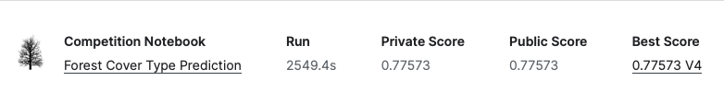
Final score

